Slide 1



Twisted Twin: A Collaborative and Competitive Memory Management Approach in HTAP Systems
Jiani Yang, Sai Wu*, Yong Wang, Dongxiang Zhang, Yifei Liu, Xiu Tang, Gang Chen
Zhejiang University & Huawei
Notes:
Hello everyone, my name is Jiani Yang. I am an PHD student from Zhejiang University. Today I am going to share our research presented in the paper “Twisted Twin: A Collaborative and Competitive Memory Management Approach in HTAP Systems”. And this work is collaborating with Huawei technology

Slide 2
GaussDB-HTAP System
OLTP
HTAP
OLAP
Notes:
Let me start by introducing the background of our work. In modern enterprises, we usually encounter two types of database workloads: OLTP, which focuses on high-throughput transactional processing, and OLAP, which supports analytical queries over large volumes of data.
Traditionally, these two workloads are served by separate systems, but this brings challenges such as low data freshness and high cost.
Therefore, HTAP was introduced, which aims to integrate OLTP and OLAP into a single system.

Slide 3



GaussDB-HTAP System
Banking
OLTP
HTAP
OLAP
Transfers
Deposits
Withdrawals
Financial Reports
Fraud Detection
OLTP
OLAP
Notes:
Taking banking as a typical example. On the OLTP side, the system must handle a large number of transactions—such as transfers, deposits, and withdrawals—at very high throughput. Any performance drop here directly impacts customers and may violate service-level agreements. On the OLAP side, the same system is also required to run analytical tasks, such as generating financial reports or detecting fraud

Slide 4
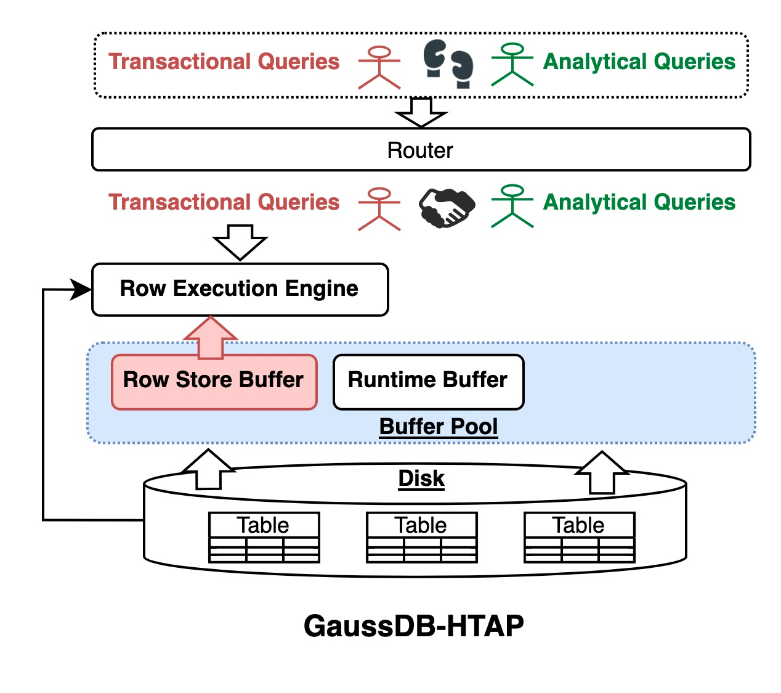
GaussDB-HTAP System
HTAP System v.s. OLTP system
Notes:
To support such mixed workloads in practice, Huawei GaussDB integrates both transactional and analytical engines on a single database instance. Let me walk you through the system design.
At the top, a router dispatches incoming queries: transactional queries are sent to the row execution engine, while analytical queries are directed to the vectorized execution engine.
Compared with a traditional OLTP system, this system introduces three key enhancements:

Slide 5
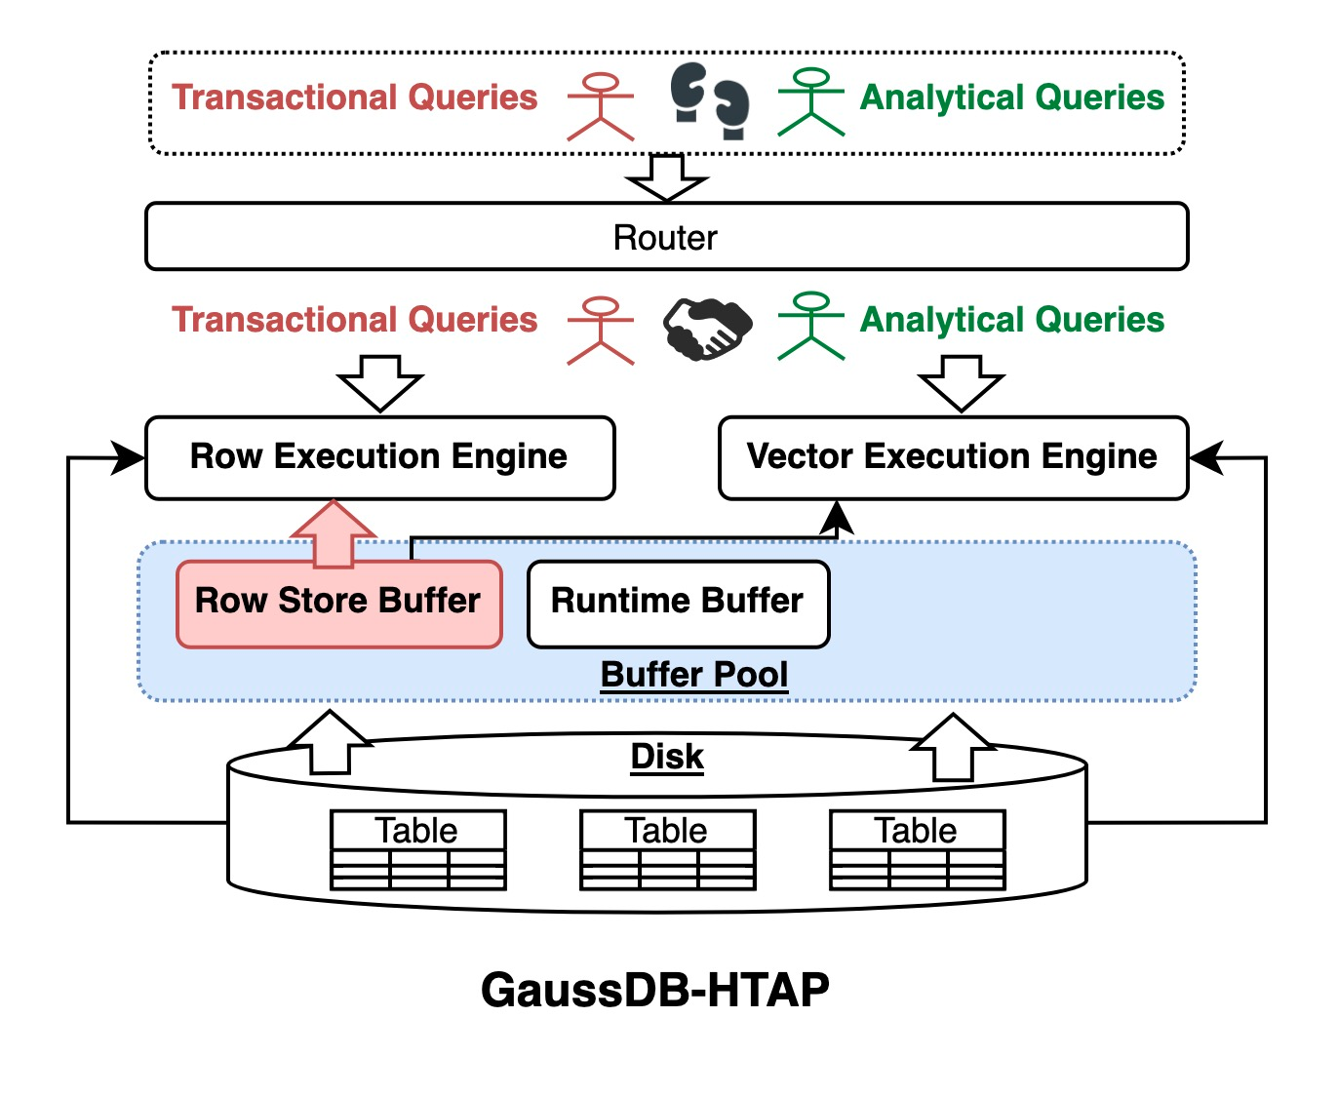
GaussDB-HTAP System
HTAP System v.s. OLTP system
Query Execution
Add vectorized engine for OLAP queries.
Figure: Architecture of Single-node HTAP system (GaussDB)
Notes:
First, in query execution, it adds a vectorized engine optimized for OLAP queries

Slide 6
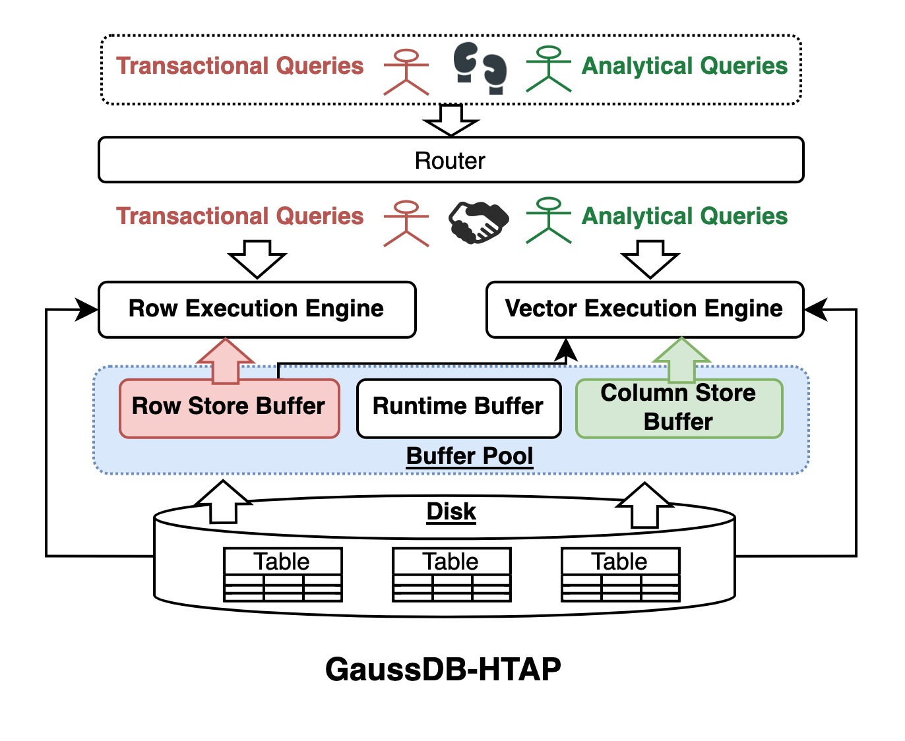
GaussDB-HTAP System
HTAP System v.s. OLTP system
Query Execution
Add vectorized engine for OLAP queries.
Support row and column storage reads.
Figure: Architecture of Single-node HTAP system (GaussDB)
Notes:
Both engines share the same underlying buffer pool, which is divided into a row store buffer for OLTP and a column store buffer for OLAP.
And the vector execution engine supports both row and column storage reads.

Slide 7
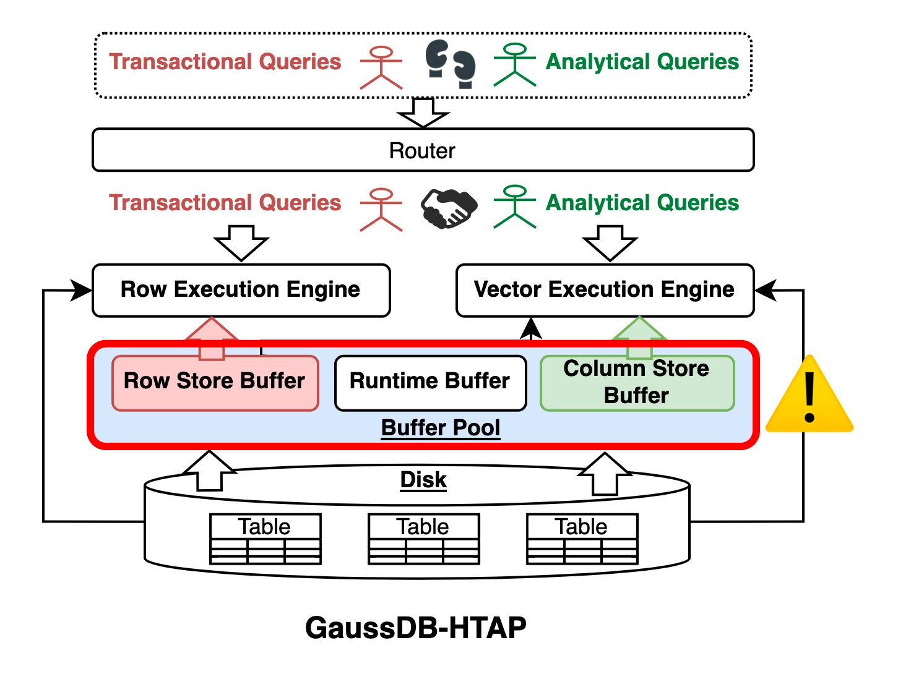
GaussDB-HTAP System
HTAP System v.s. OLTP system
Query Execution
Add vectorized engine for OLAP queries.
Support row and column storage reads.
Resource Scheduling
Shared buffer split into row/column zones
Notes:
Second, in resource scheduling, the shared buffer is explicitly divided into row and column zones. This means the system must carefully decide how to partition the limited memory between the two.

Slide 8
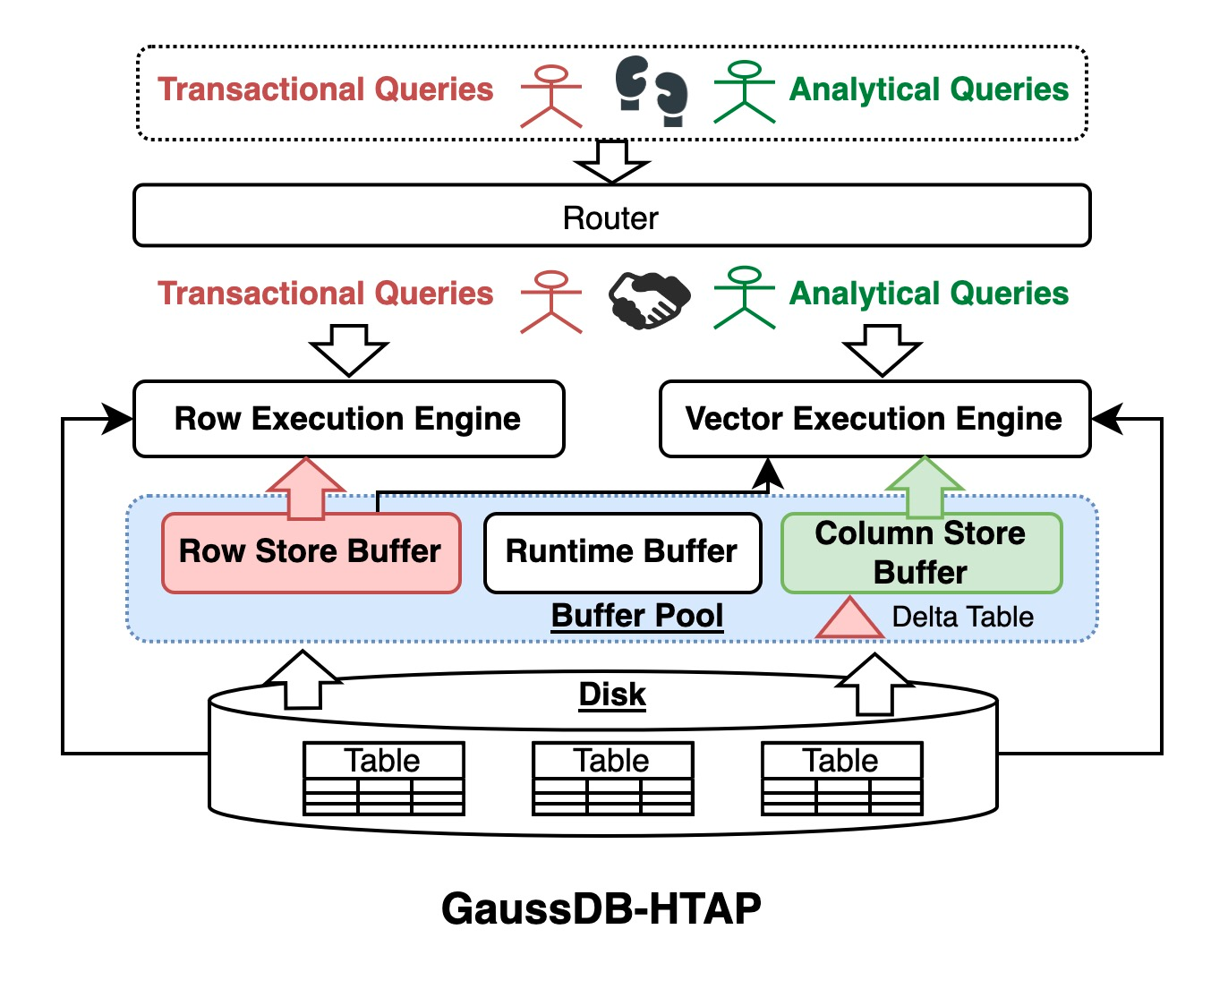
GaussDB-HTAP System
HTAP System v.s. OLTP system
Query Execution
Add vectorized engine for OLAP queries.
Support row and column storage reads.
Resource Scheduling
Shared buffer split into row/column zones
Data Synchronization
Use Delta Table to store updates and periodically sync with column store.
Notes:
And third, since the row-format data and the column-format data need to stay consistent, we introduce delta tables. They temporarily store updates and then periodically merge them into the column store as data synchronization.
However, such system also introduces new problems.

Slide 9


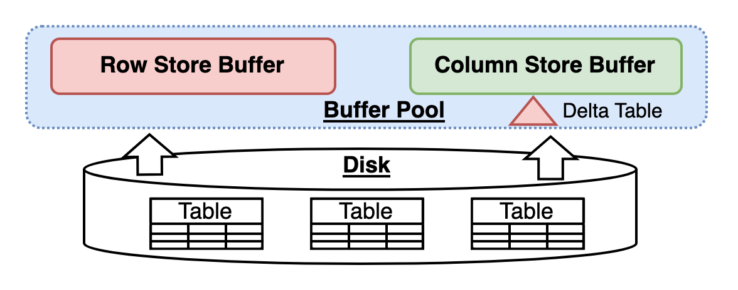
Problems – Column Selection
？
Problem 1: What Data Should Be Loaded into the Column Store
OLAP
🐢
Seq Scan
Column Scan
🐰
Filter
Filter
Slow
Fast
Row Format Data
Column Format Data
Notes:
First problem: column selection.
For analytical queries, there are two possible scan paths. If the query has to go through the row store buffer, it ends up doing a sequential scan, which is relatively slow. On the other hand, if the required columns are already loaded into the column store buffer, the system can use a column scan, which is much faster.
But the challenge is: what data should be loaded into the column store?

Slide 10
Problems – Column Selection
？
Problem 1: What Data Should Be Loaded into the Column Store
OLAP
🐢
Seq Scan
Column Scan
🐰
Filter
Filter
Select Columns with Instructions Manually
Slow
Fast
ALTER TABLE customer COLVIEW(companyid, name);
ALTER TABLE sales COLVIEW(order_id, customer_id);
ALTER TABLE product COLVIEW(product_id, name, price);
Row Format Data
Column Format Data
Notes:
Currently, the system requires users to manually specify which columns should be cached, using instructions like ALTER TABLE … COLVIEW. This manual process is not only labor-intensive, but also suboptimal—users may not know which columns will actually benefit query performance the most.

Slide 11

Problems – Memory Allocation
？
Problem 2 : How to Allocate Memory for Row Store and Column Store
Notes:
The second problem is about memory allocation.
In GaussDB-HTAP, both OLTP and OLAP share the same buffer pool. But the question is: how should we divide this limited memory between the row store and the column store?

Slide 12
Problems – Memory Allocation
？
Problem 2 : How to Allocate Memory for Row Store and Column Store
OLTP: More memory helps cache hot data, reducing I/O and improving throughput.
Notes:
For OLTP, More memory helps cache hot data, reducing I/O and improving TPS.

Slide 13
Problems – Memory Allocation
？
Problem 2 : How to Allocate Memory for Row Store and Column Store
OLTP: More memory helps cache hot data, reducing I/O and improving throughput.
OLAP: More memory allows more columns to be cached, reducing I/O from the row store.
Notes:
For OLAP, More memory allows more columns to be cached, reducing I/O from the row store.
Essentially, OLTP and OLAP are competing for the same resource. As shown in the figure, it’s like two players pulling on the same ball.

Slide 14
Problems – Memory Allocation
？
Problem 2 : How to Allocate Memory for Row Store and Column Store
OLTP: More memory helps cache hot data, reducing I/O and improving throughput.
OLAP: More memory allows more columns to be cached, reducing I/O from the row store.
Memory Allocation through Database Configuration
SET ROW_STORE_BUFFER = 80G
SET COLUMN_STORE_BUFFER = 20G;
20G ?
Or 80G ?
Notes:
Today, memory allocation is usually done through static configuration parameters, such as setting the row store buffer to 80GB and the column store buffer to 20GB, or the other way around. But this approach is rigid and suboptimal, because the optimal split really depends on the workload, which fluctuates over time.

Slide 15


Issues of Current Approaches
Issue 1: Experience-based, Suboptimal
Manual memory allocation may result in memory utilization dropping below 50% at certain times.
Notes:
Like we just said, nowadays we rely on DBAs to tune the HTAP system. But this approach suffers from two major issues.
First, they are experience-based and often suboptimal. For example, Manual memory allocation may result in memory utilization dropping below 50% at certain times.

Slide 16
Issues of Current Approaches
Issue 1: Experience-based, Suboptimal
Manual memory allocation may result in memory utilization dropping below 50% at certain times.
Issue 2: Costly, Time-consuming
DBA tuning for database column selection usually takes several hours or even days.
Notes:
Second, they are costly and time-consuming. For example, tuning database column selection can take hours or even days.

Slide 17
Issues of Current Approaches
Issue 1: Experience-based, Suboptimal
Manual memory allocation may result in memory utilization dropping below 50% at certain times.
Issue 2: Costly, Time-consuming
DBA tuning for database column selection usually takes several hours or even days.
Challenges
Large Problem Search Space
Highly Coupled Components
Notes:
But actually, column selection and memory allocation are far from trivial — they come with two major challenges.
First, the search space is extremely large, since we must consider many possible combinations of memory partitions and column sets. Second, the components are highly coupled. Memory allocation, column selection, and data synchronization all affect each other.

Slide 18
Issues of Current Approaches
Issue 3: Failing to Exploit Optimization Opportunities
Real workloads show a clear tidal pattern:
Daytime → OLTP Dominates (transactions, risk checks)
Nighttime → OLAP Dominates (batch jobs, reports)
Notes:
Moreover, current approaches fail to exploit optimization opportunities.
If we look at real workloads, they often follow a clear tidal pattern. During the daytime, OLTP dominates, with heavy transactional workloads such as transfers or risk checks. During the nighttime, OLAP dominates, with batch jobs and generating reports.

Slide 19
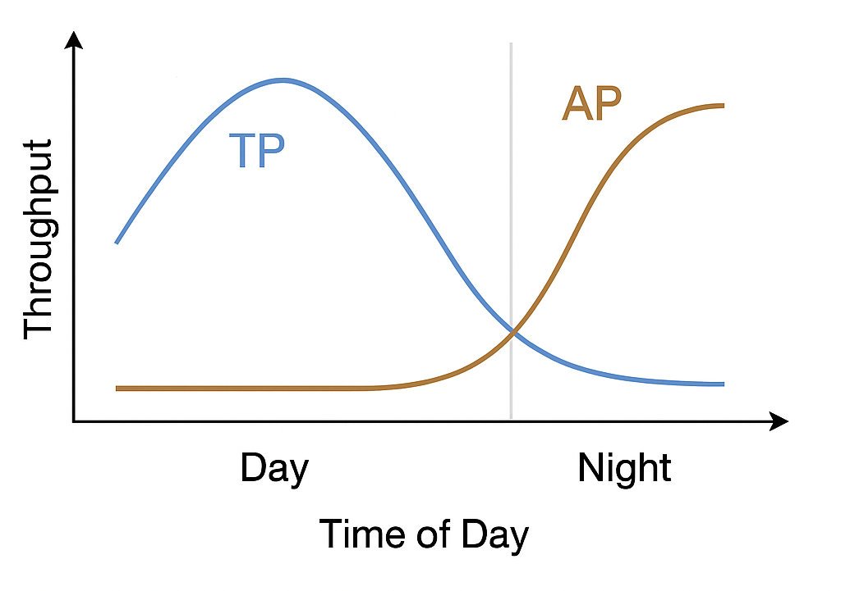
Issues of Current Approaches
Issue 3: Failing to Exploit Optimization Opportunities
Real workloads show a clear tidal pattern:
Daytime → OLTP Dominates (transactions, risk checks)
Nighttime → OLAP Dominates (batch jobs, reports)
Smart resource rebalancing can greatly boost overall utilization.
Notes:
This means that if the system could perform smart resource rebalancing, for example shifting more memory to OLTP during the day and to OLAP at night, we could greatly improve overall utilization.

Slide 20
Issues of Current Approaches
Issue 3: Failing to Exploit Optimization Opportunities
Real workloads show a clear tidal pattern:
Daytime → OLTP Dominates (transactions, risk checks)
Nighttime → OLAP Dominates (batch jobs, reports)
Smart resource rebalancing can greatly boost overall utilization.
Higher Demands on System Optimization:
Real-time Response
Adaptive Adjustment
Notes:
But existing approaches cannot do this. This introduce higher demands on system Optimization, such as real-time response and adaptive adjustment, which are critical for handling dynamic workloads in HTAP systems.

Slide 21

Issues of Current Approaches
Issue 3: Failing to Exploit Optimization Opportunities
Real workloads show a clear tidal pattern:
Daytime → OLTP dominates (transactions, risk checks)
Nighttime → OLAP dominates (batch jobs, reports)
Smart resource rebalancing can greatly boost overall utilization.
Autodriven HTAP System
Higher Demands on System Optimization:
Real-time Response
Adaptive Adjustment
Notes:
So These issues motivate us to design an autodriven HTAP system

Slide 22
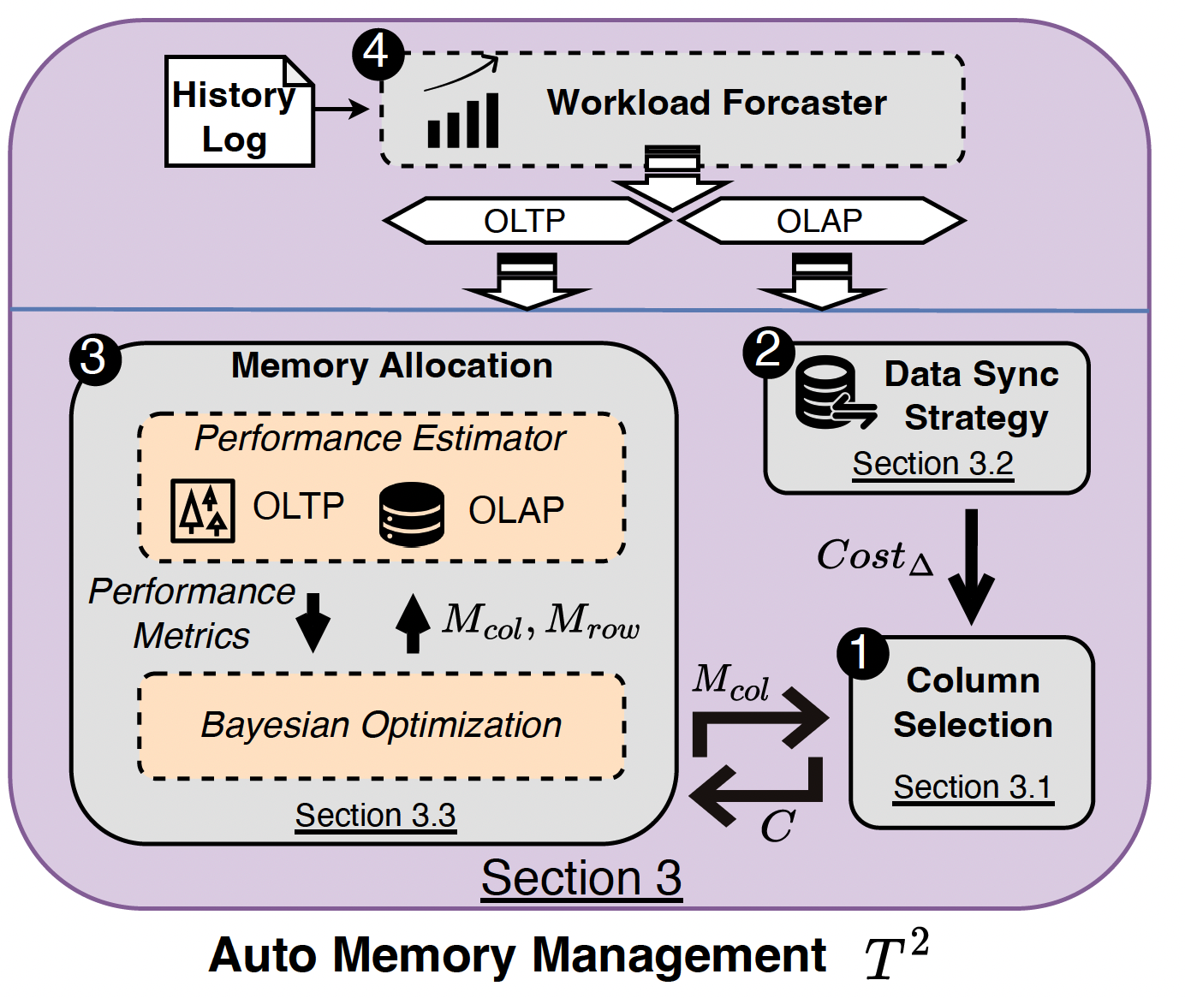
Introducing T² (Twisted-Twin)
Optimization Goal
Ensure OLTP throughput as the first priority, and maximize OLAP performance on top of it.
Notes:
To address these challenges, we propose T²
From our experience with GaussDB customers, their biggest concern when migrating from a traditional OLTP system to an HTAP system is that transactional performance might be compromised. Therefore, the optimization goal of T² is clear:
First, ensure OLTP throughput as the top priority.
And then, maximize OLAP performance on top of it.

Slide 23
Introducing T² (Twisted-Twin)
Optimization Goal
Ensure OLTP throughput as the first priority, and maximize OLAP performance on top of it.
Two-Phase Strategy
Phase 1: Static Configuration
Phase 2: Dynamic Tuning (Invokes Static Configuration When Needed)
Notes:
To achieve this, T² follows a two-phase strategy.
Phase 1 is static configuration, which generate a tuning plan for workloads that stay relatively stable.
Phase 2 is dynamic tuning, which builds on top of the static configuration and is triggered whenever the workload undergoes significant changes.

Slide 24
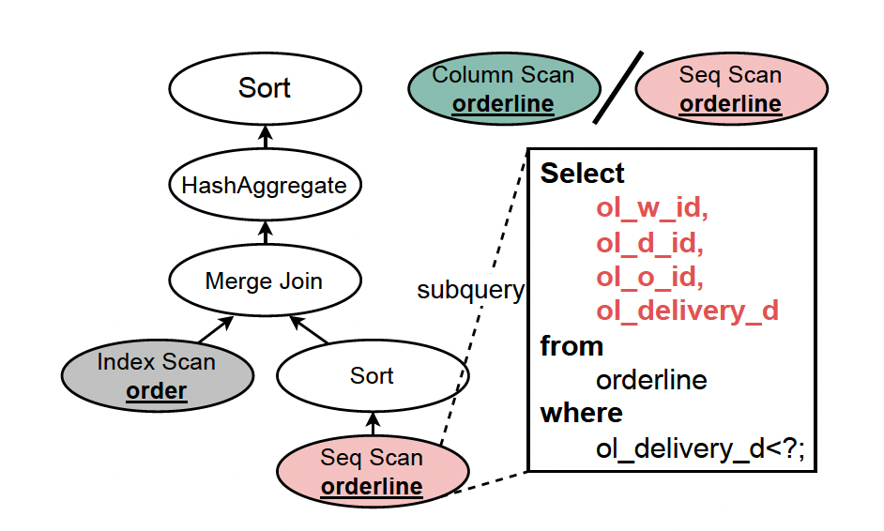
Static Configuration – Column Selection
Column Selection → Knapsack Problem Variant
Limited memory space
→ knapsack with limited capacity
Notes:
Let’s first look at column selection in the static configuration phase.
Actually, the column selection problem can be regarded as a variant of the Knapsack Problem. For example, the fact that memory space is limited is similar to a knapsack with limited capacity.

Slide 25
Static Configuration – Column Selection
Column Selection → Knapsack Problem Variant
Limited memory space
→ knapsack with limited capacity
Reading from column store is faster than from row store
→ item value
Notes:
Next, reading data from the column store is faster than from the row store, so each column can be treated as an item with a value, representing its benefit to OLAP queries.

Slide 26
Static Configuration – Column Selection
Column Selection → Knapsack Problem Variant
Limited memory space
→ knapsack with limited capacity
Reading from column store is faster than from row store
→ item value
A query can use column scan only if all its required columns are in memory
→ knapsack with dependency constraints
Notes:
Finally, a query can only use a column scan if all its required columns are loaded in memory. For example, take the query on the right. It involves four columns, and it can only be executed as a column scan if all four columns are loaded into memory.
This introduces dependency constraints between items, which makes the problem more complex than a standard knapsack.

Slide 27
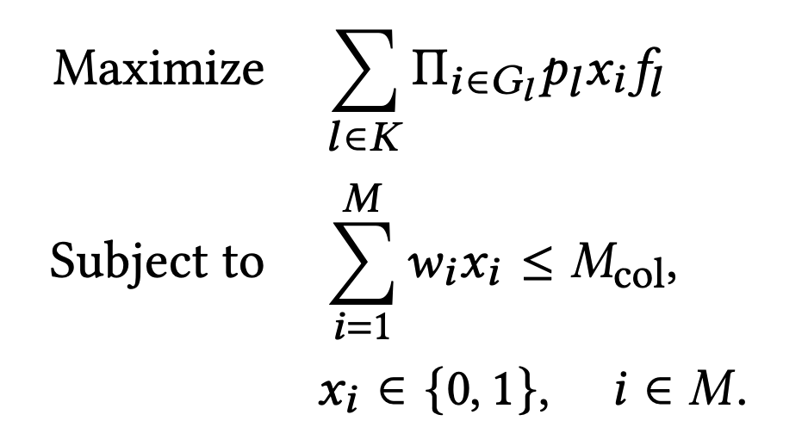
Static Configuration – Column Selection
Problem Formulation：
Notes:
We formalize this problem and find that it is essentially a nonlinear integer programming problem, which is very inefficient to solve directly.

Slide 28
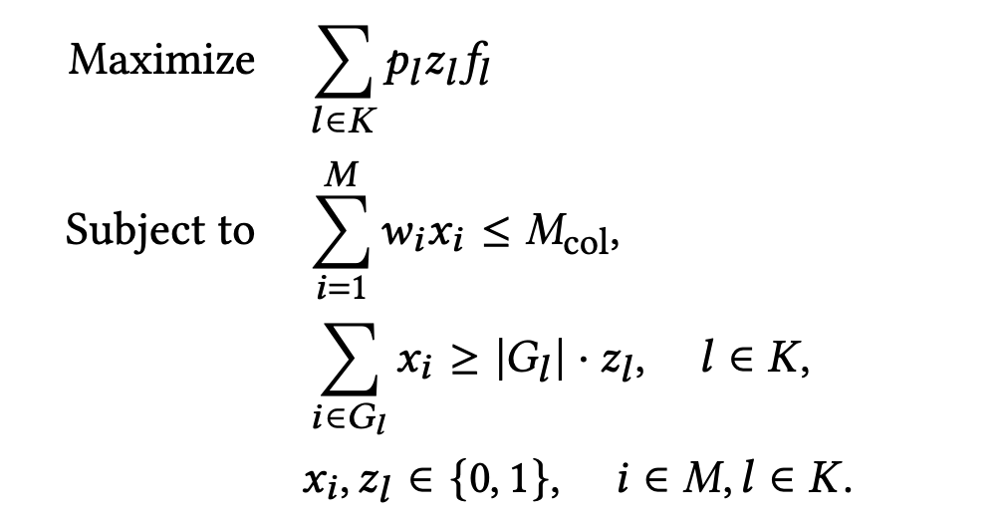
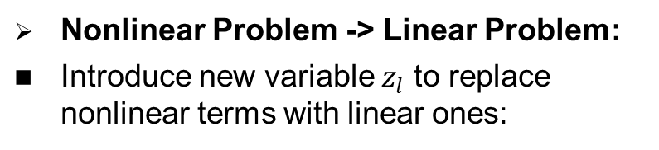
Static Configuration – Column Selection
Problem Formulation：
Nonlinear Problem -> Linear Problem:
Introduce new variable $z_{l}$ to replace nonlinear terms with linear ones:
Notes:
To speed up the process, we introduce a new variable to replace the nonlinear terms, which transforms the problem into a linear integer programming problem. Such a problem can be solved by existing integer programming solvers. However, the scale of the problem still grows exponentially with the number of queries.

Slide 29
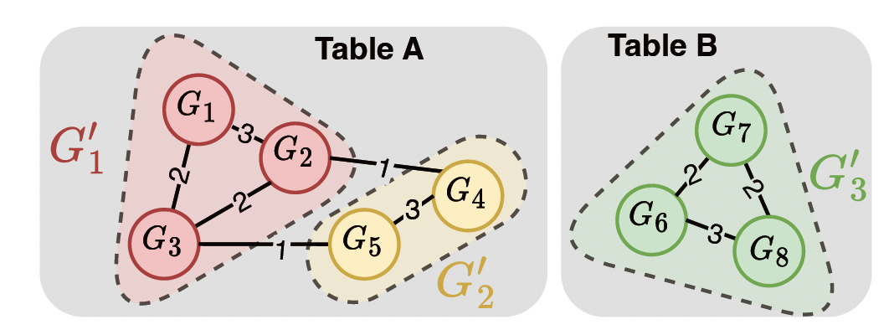
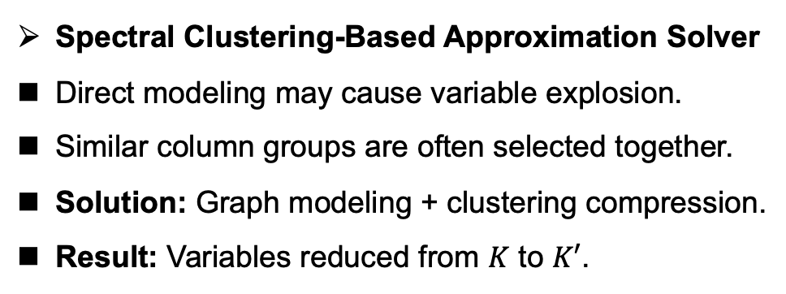
Static Configuration – Column Selection
Problem Formulation：
Nonlinear Problem -> Linear Problem:
Introduce new variable $z_{l}$ to replace nonlinear terms with linear ones:
Spectral Clustering-Based Approximation Solver
Direct modeling may cause variable explosion.
Similar column groups are often selected together.
Solution: Graph modeling + clustering compression.
Result: Variables reduced from $K$ to $K′$.
Notes:
To further address this, we design a Spectral Clustering-Based Approximation Solver. The idea is to cluster similar column groups together, and use a single decision variable to represent one cluster. In this way, we significantly reduce the dimensionality of the problem and make it much more efficient to solve.

Slide 30
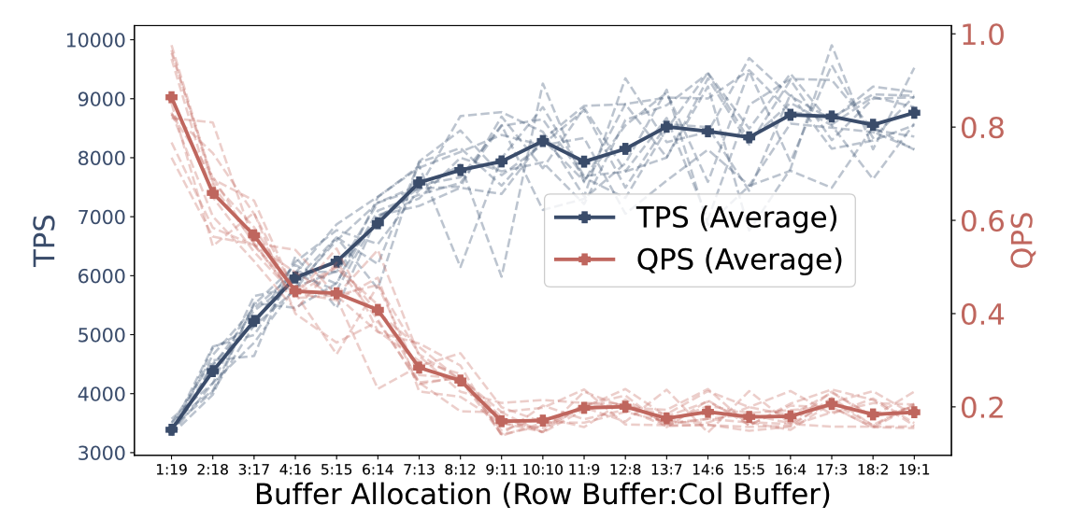
Static Configuration – Memory Allocation
Why is Memory Allocation Non-Trivial?
Intuitions:
Model throughput-to-memory function
Prioritize TP throughput, then allocate the rest memory to AP
Figure: The Impact of Buffer Allocation Between Row Store and Column Store
Notes:
Now let’s turn to the memory allocation problem.
In the figure on the right, the x-axis shows the memory ratio between the row buffer and the column buffer. As we move to the right, more memory is allocated to the row store. We can clearly see that as the row store memory increases, the curve representing OLTP throughput keeps going up, while the curve representing OLAP throughput keeps going down.
At first glance, the intuition seems straightforward:
We could try to model a throughput-to-memory function,
Then prioritize TP throughput, and simply allocate the remaining memory to AP.

Slide 31
Static Configuration – Memory Allocation
Why is Memory Allocation Non-Trivial?
Intuitions:
Model throughput-to-memory function
Prioritize TP throughput, then allocate the rest memory to AP
Not Feasible in Practice:
TP and AP compete for I/O when co-located
Performance interference makes the function hard to predict
Figure: The Impact of Buffer Allocation Between Row Store and Column Store
Notes:
However, this idea does not work well in practice. The reason is that TP and AP compete for I/O when they are co-located, and this causes severe performance interference. As a result, the throughput-to-memory function becomes very difficult to predict.

Slide 32
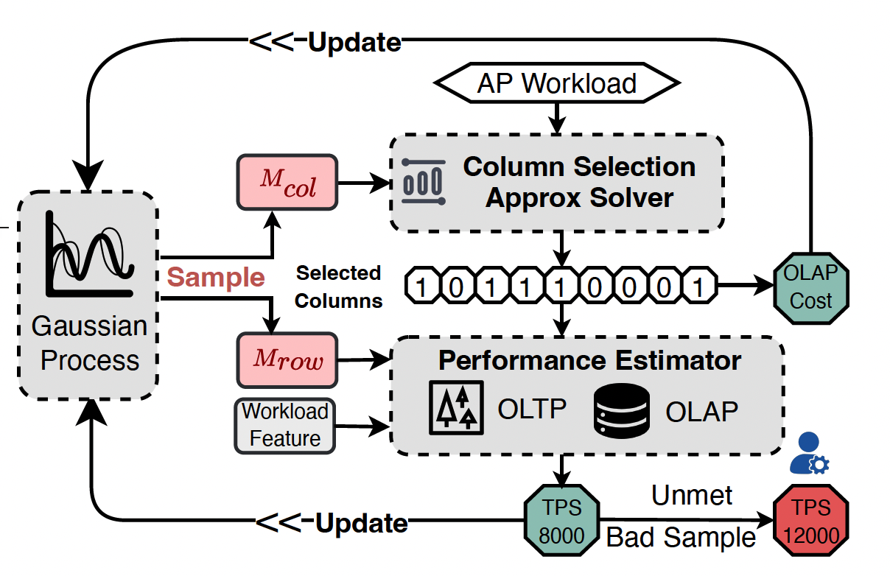
Static Configuration – Memory Allocation
Bayesian-based Optimization Workflow
Collect samples & costs
Build surrogate model
Select candidate (e.g., EI)
Evaluate & update
Iterate to optimal TPS-aware allocation
Notes:
So instead, we turn to a more powerful tool, and that is Bayesian Optimization.
The idea is to treat memory allocation as a black-box optimization problem. We don’t have an explicit analytical model for the throughput-to-memory function, but we can iteratively learn it from samples.
As shown on the right, Our method follows a process very similar to standard Bayesian Optimization, so I won’t go into the step-by-step details here.

Slide 33
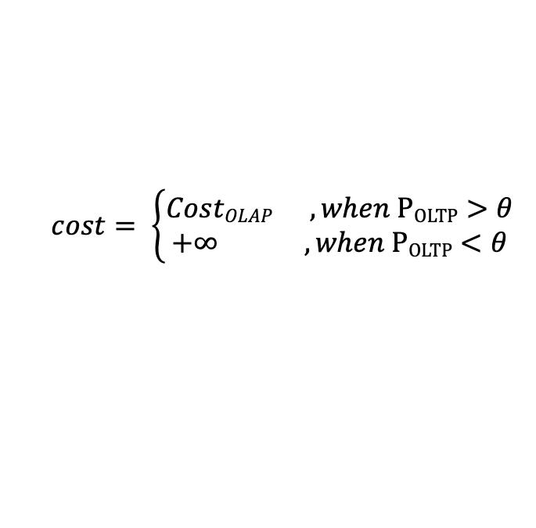
Static Configuration – Memory Allocation
Bayesian-based Optimization Workflow
Collect samples & costs
Build surrogate model
Select candidate (e.g., EI)
Evaluate & update
Iterate to optimal TPS-aware allocation
Cost Evaluation
$$cost= \left\{\begin{aligned}CostOLAP ,when POLTP>θ \\ +∞ ,when POLTP<θ \end{aligned}\right.$$
Notes:
The key difference lies in how we define the cost function. In our cost evaluation, we always enforce OLTP throughput as the first priority. If OLTP throughput drops below the threshold, the cost is treated as infinite, which guarantees that transactional performance is never compromised. Once OLTP meets the threshold, we then use the OLAP query cost as the overall metric.

Slide 34
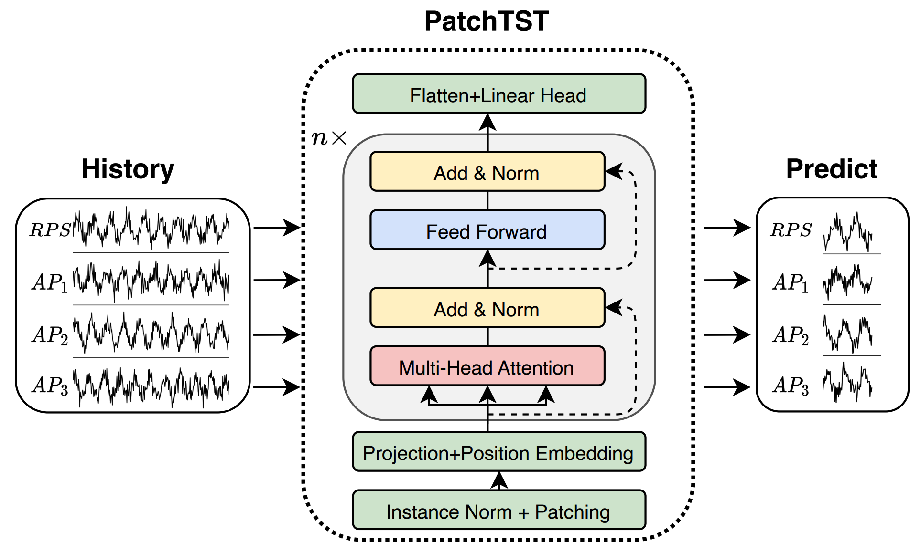
Dynamic Tuning
Predict Future Workloads, Plan Ahead
Use historical load patterns to forecast future trends
Notes:
So up to this point, for static workloads, we are able to automatically choose the right columns and assign memory properly. But in reality, workloads are rarely static — they fluctuate over time — which motivates the need for dynamic tuning.
The first step is to predict future workloads and plan ahead. We leverage historical load patterns and adopt a forecasting model PatchTST — to predict both transactional and analytical query rates in the near future.

Slide 35
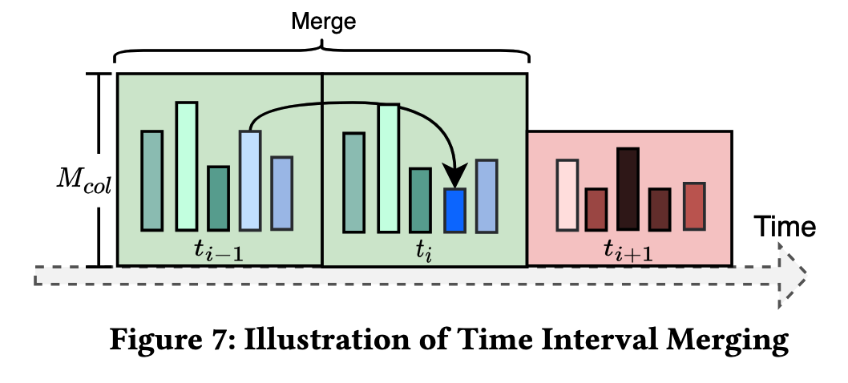
Dynamic Tuning
Predict Future Workloads, Plan Ahead
Trigger Timing Selection
Use historical load patterns to forecast future trends
Greedy algorithm: reconfigure when benefits outweigh costs.
Notes:
The second step is to carefully decide when to trigger reconfiguration. Here we use a greedy strategy: we only reconfigure when the expected benefits outweigh the costs. As shown in the figure, multiple short intervals can be merged to avoid frequent reconfigurations, so that we strike a balance between benefits and costs.

Slide 36
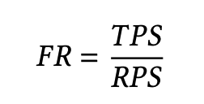
Experiment: Overall Performance
Metrics
Metric for measuring OLTP performance
(System Throughput)
(User Demand)
Notes:
And that’s all for our technical design. Let me now move to the evaluation results of T² on GaussDB-HTAP.
We use two main metrics:
For OLTP, we introduce a metric called the Fulfillment Ratio. Here, the numerator is the achieved throughput (TPS), and the denominator is the user demand (RPS). When the fulfillment ratio equals 1, it means the system can fully meet the current demand. For OLAP, we use the improvement ratio (Impr) which denotes the performance improvement compared to the original GaussDB.

Slide 37
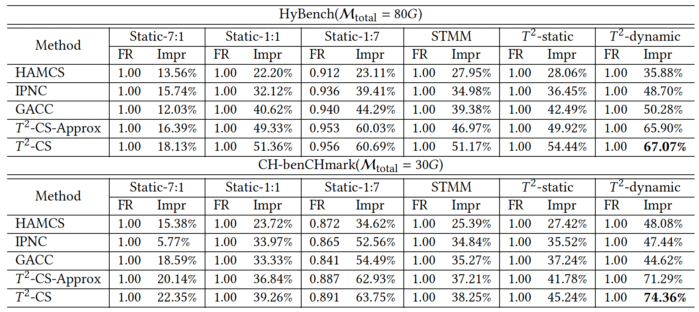
Experiment: Overall Performance
Metrics
Metric for measuring OLTP performance
(System Throughput)
(User Demand)
Overall Performance
Notes:
On the left table you can see the overall performance across different workloads. Compared with existing approaches, T² consistently achieves the best balance: Since OLTP performance is our first priority, the Fulfillment Ratio (FR) always stays at 1, meaning OLTP demand is fully satisfied. At the same time, OLAP performance improves significantly — by up to 67% on HyBench and 74% on CH-benCHmark.

Slide 38
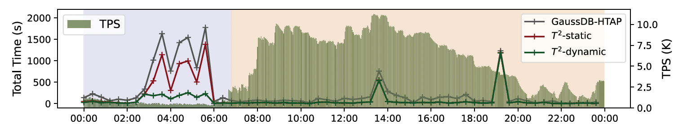
Experiment: Overall Performance
Metrics
Metric for measuring OLTP performance
Metric for measuring OLAP performance
(System Throughput)
(User Demand)
Overall Performance
One-Day Workload Simulation on GaussDB-HTAP with T²
Notes:
On the right, we show a 24-hour workload simulation on GaussDB-HTAP.
The green bars denote the TPS during the day, and the three lines represent OLAP query latency. We can see that with the help of T², OLTP demand is fully satisfied, while at the same time OLAP latency drops significantly. This demonstrates that T² makes much better use of the limited resources.

Slide 39
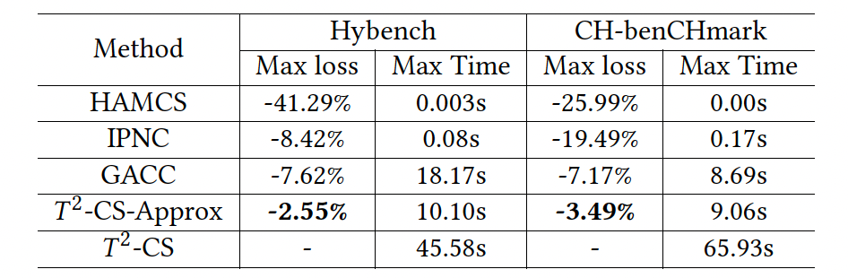
Experiment: Column Selection
Impact of T² Column Selection Algorithms
Although some competing methods occasionally achieve performance similar to that of 𝑇², they are prone to getting trapped in local optima, leading to a higher max loss.
Notes:
So that’s the overall performance. Next, let’s take a quick look at how each module helps. First, column selection.
Competing methods sometimes match T², but they often fall into local optima, causing large max losses — up to -41%. In contrast, the approximation solver for column selection keeps the loss very low (around -2% to -3%) while also being very efficient to solve.

Slide 40
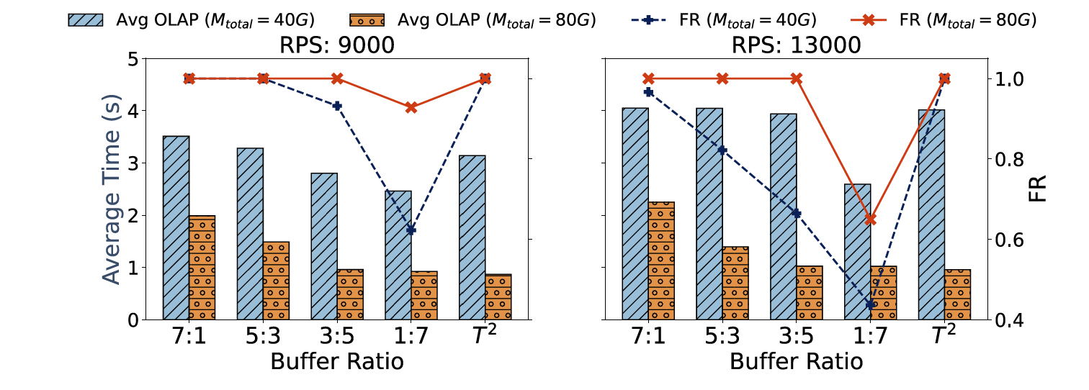
Experiment: Static Memory Allocation
Compare 𝑇 ² to Fixed Ratio Memory Allocation
Our dynamic approach balances IO overhead and query performance
Notes:
Next, memory allocation.
Here we compare T² with several fixed ratio memory allocations. Fixed ratios are very sensitive — a wrong split hurts either OLTP or OLAP. In contrast, T² keeps OLTP demand fully met (FR ≈ 1.0) while reducing OLAP time, showing a better balance overall.

Slide 41
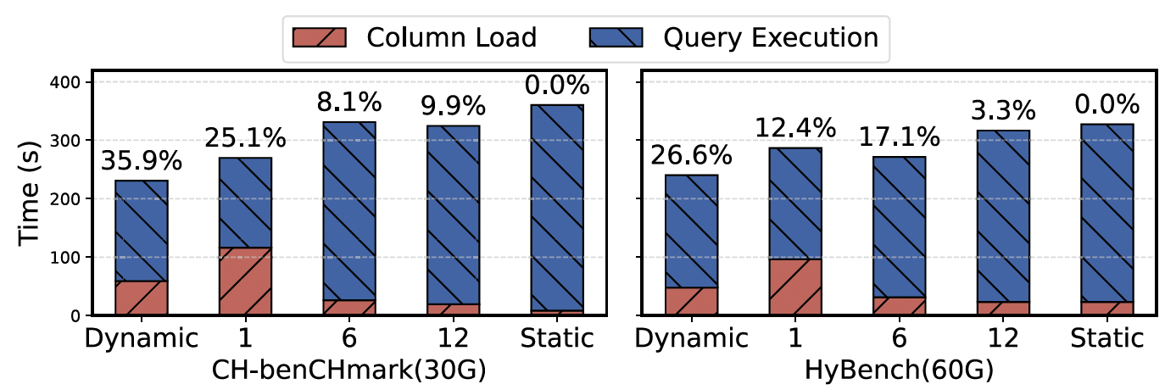
Experiment: Dynamic Reallocation
Effect of Reallocation Trigger Algorithm
The percentages in the figure represent the percentage reduction in total time relative to the static algorithm
Notes:
Next, dynamic reallocation.
Compared with static allocation, dynamic reallocation reduces the total time by up to 35%. We jointly consider column load and query execution, and optimize for the overall cost.

Slide 42
Q&A
Twisted Twin: A Collaborative and Competitive Memory Management Approach in HTAP Systems
Jiani Yang, Sai Wu*, Yong Wang, Dongxiang Zhang, Yifei Liu, Xiu Tang, Gang Chen
Zhejiang University & Huawei
Email: jianiyang_cs@zju.edu.cn
Notes:
To wrap up, with T² we can keep OLTP safe while speeding up OLAP, making much better use of the same resources. This brings us closer to truly efficient and practical HTAP systems.
That concludes my presentation. Thank you for your attention, and I’d be happy to take any questions.

